Slide 1

FAIRNESS ANALYSIS OF OLYMPICS (1976 - 2008):
The Impact of Gender and Economic Status on the Games

Slide 2
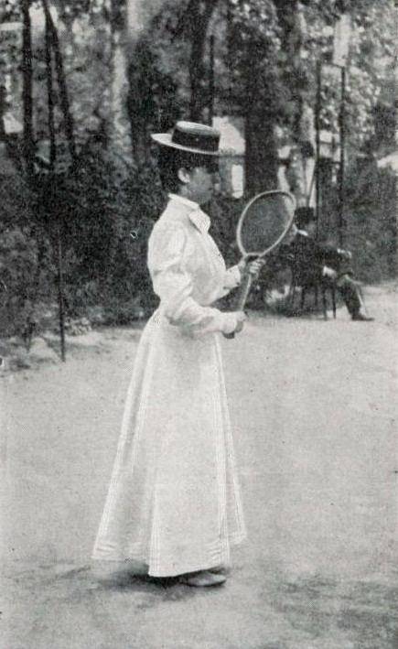
Introduction
Historically, societal perceptions of gender roles led to the exclusion of women from many sporting events including the Olympics. It wasn’t until the 1900 Summer Olympics that women were first allowed to compete, though their participation remained minimal for many years.

Slide 3
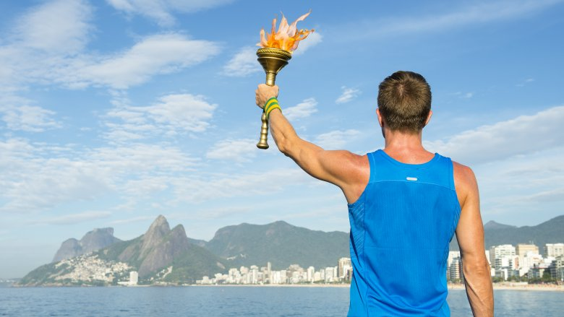
How fair and unbiased have these games truly been?

Slide 4
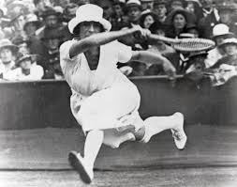
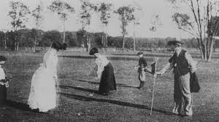
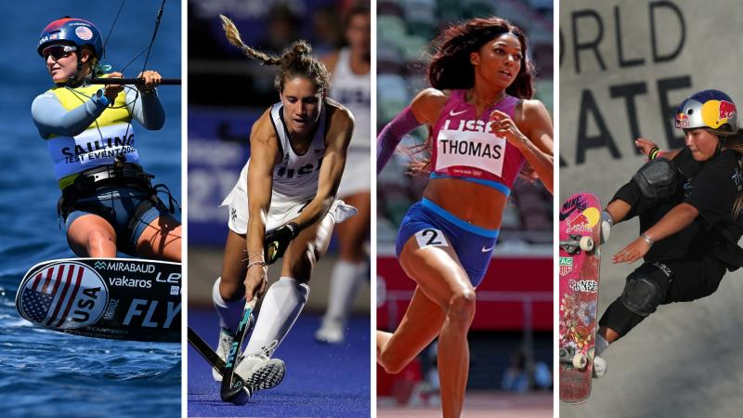
Gender Inclusion and Progress
The world of athletics was historically male-dominated, including the Olympics. It wasn't until the 1900s that efforts began to include women in the Games, with events such as golf, tennis, and croquet.

Slide 5
Gender Inclusion and Progress
Over the years, female participation in the Olympics has steadily increased. Gender distribution data shows that inclusion efforts, through the introduction of more events for women, have led to progress—though at a gradual pace.

Slide 6
Gender Inclusion and Progress
However, significant gender disparities persist in several sports. Events like canoeing, football, sailing, and others. This underscores the need for greater efforts to achieve gender equality across all Olympic sports.

Slide 7

Economic Influence on Medal Distribution
Another crucial aspect of fairness in the Olympics is the influence of a country’s economic status on performance. The distribution of medals across First World, Second World, and Third World countries reveals an interesting pattern:

Slide 8
Economic Influence on Medal Distribution
First and Second World countries have a higher share of medals per country, which is largely attributed to their greater investment in athlete training, facilities, and development programs.

Slide 9
Economic Influence on Medal Distribution
Third World countries, despite their greater numbers, tend to win fewer medals per country due to limited resources and funding for sports infrastructure.

Slide 10
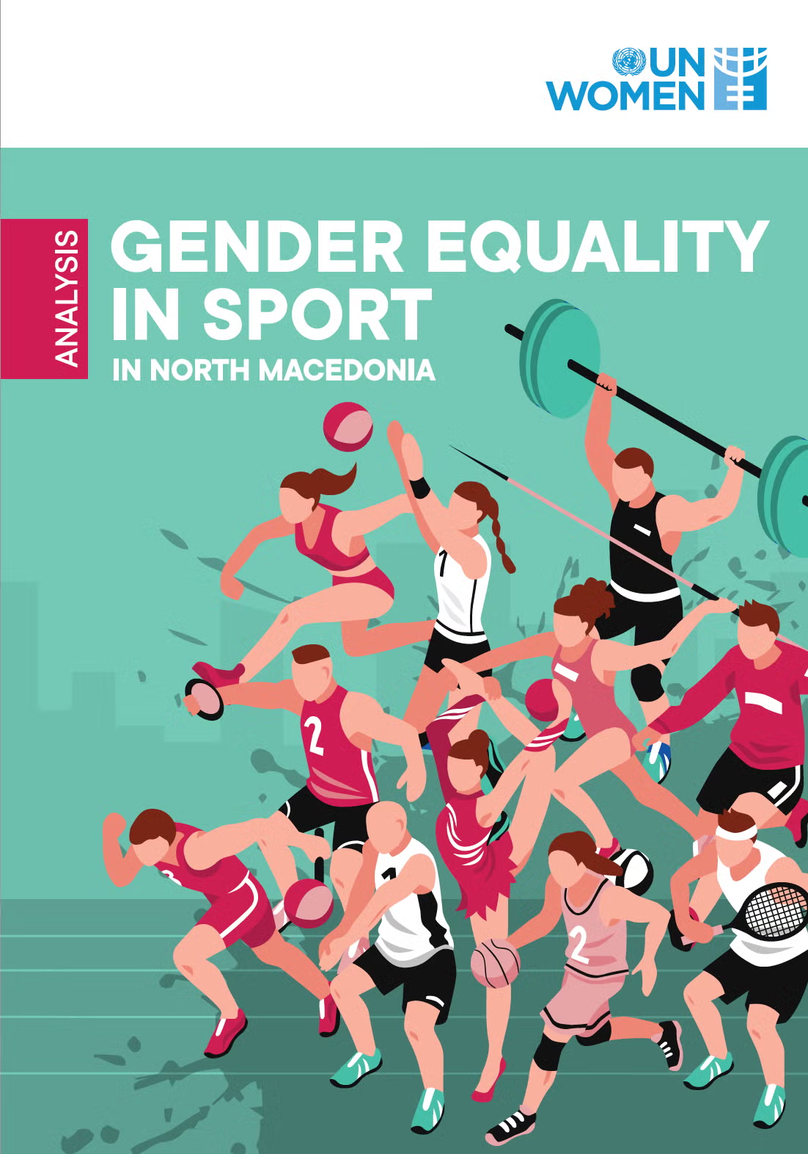
Recommendations
Accelerate Gender Parity:
Expand women’s events across all sports.
Ensure equal representation of men and women in all areas of the Games.

Slide 11

Recommendations
2.Address Economic Disparity:
Enhance funding support for athletes from economically disadvantaged nations.
Provide training scholarships to promising athletes regardless of their economic background.

Slide 12
Recommendations
2.Address Economic Disparity:
Establish resource-sharing programs to ensure athletes from less affluent countries have access to high-performance training facilities and coaching

Slide 13
Conclusion
Despite progress towards fairness, gender bias and economic disparity persist in the Olympics, with men still dominating in participation and events and athletes from wealthier nations maintain an advantage due to better training facilities and resources.

Slide 14
Appendix

Slide 15
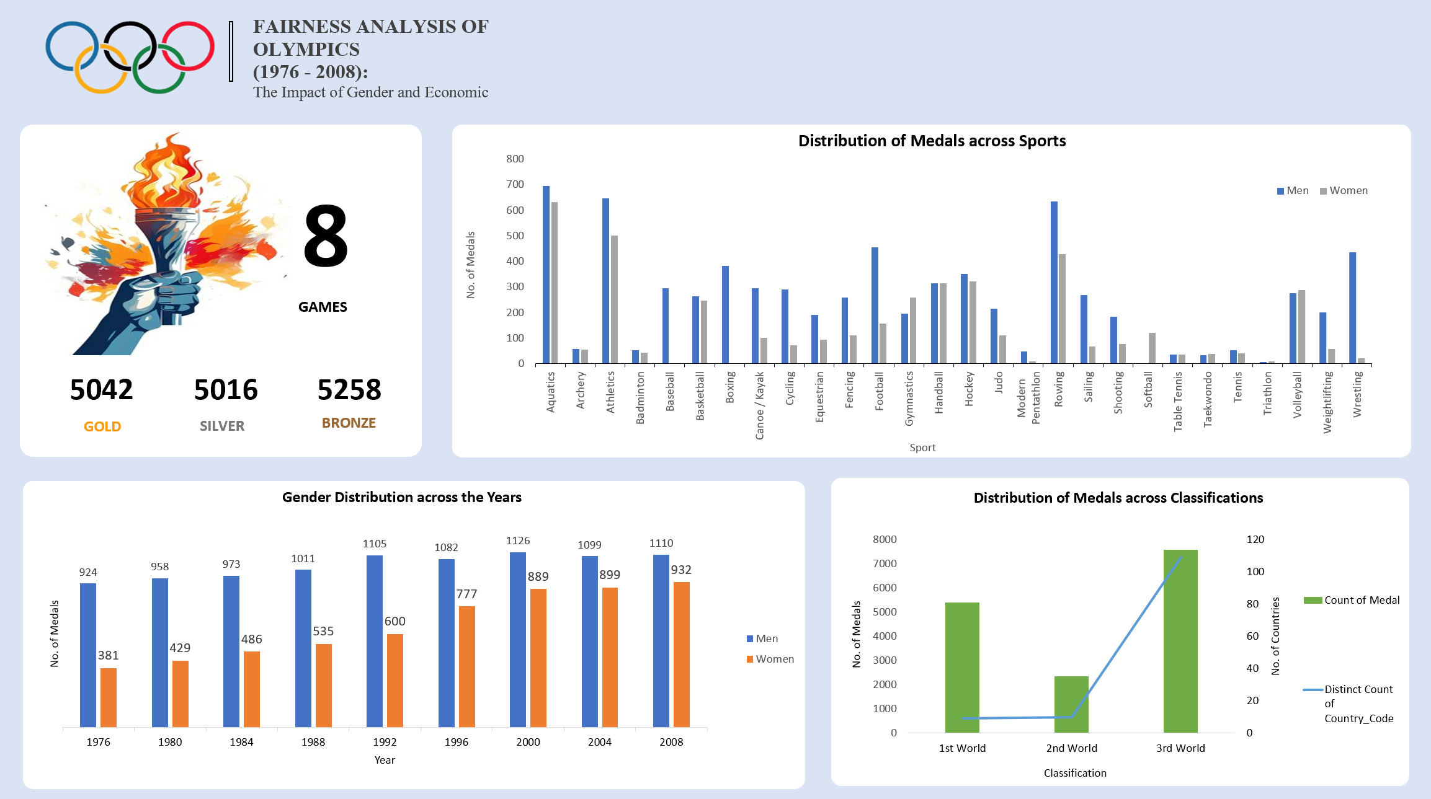

Slide 16
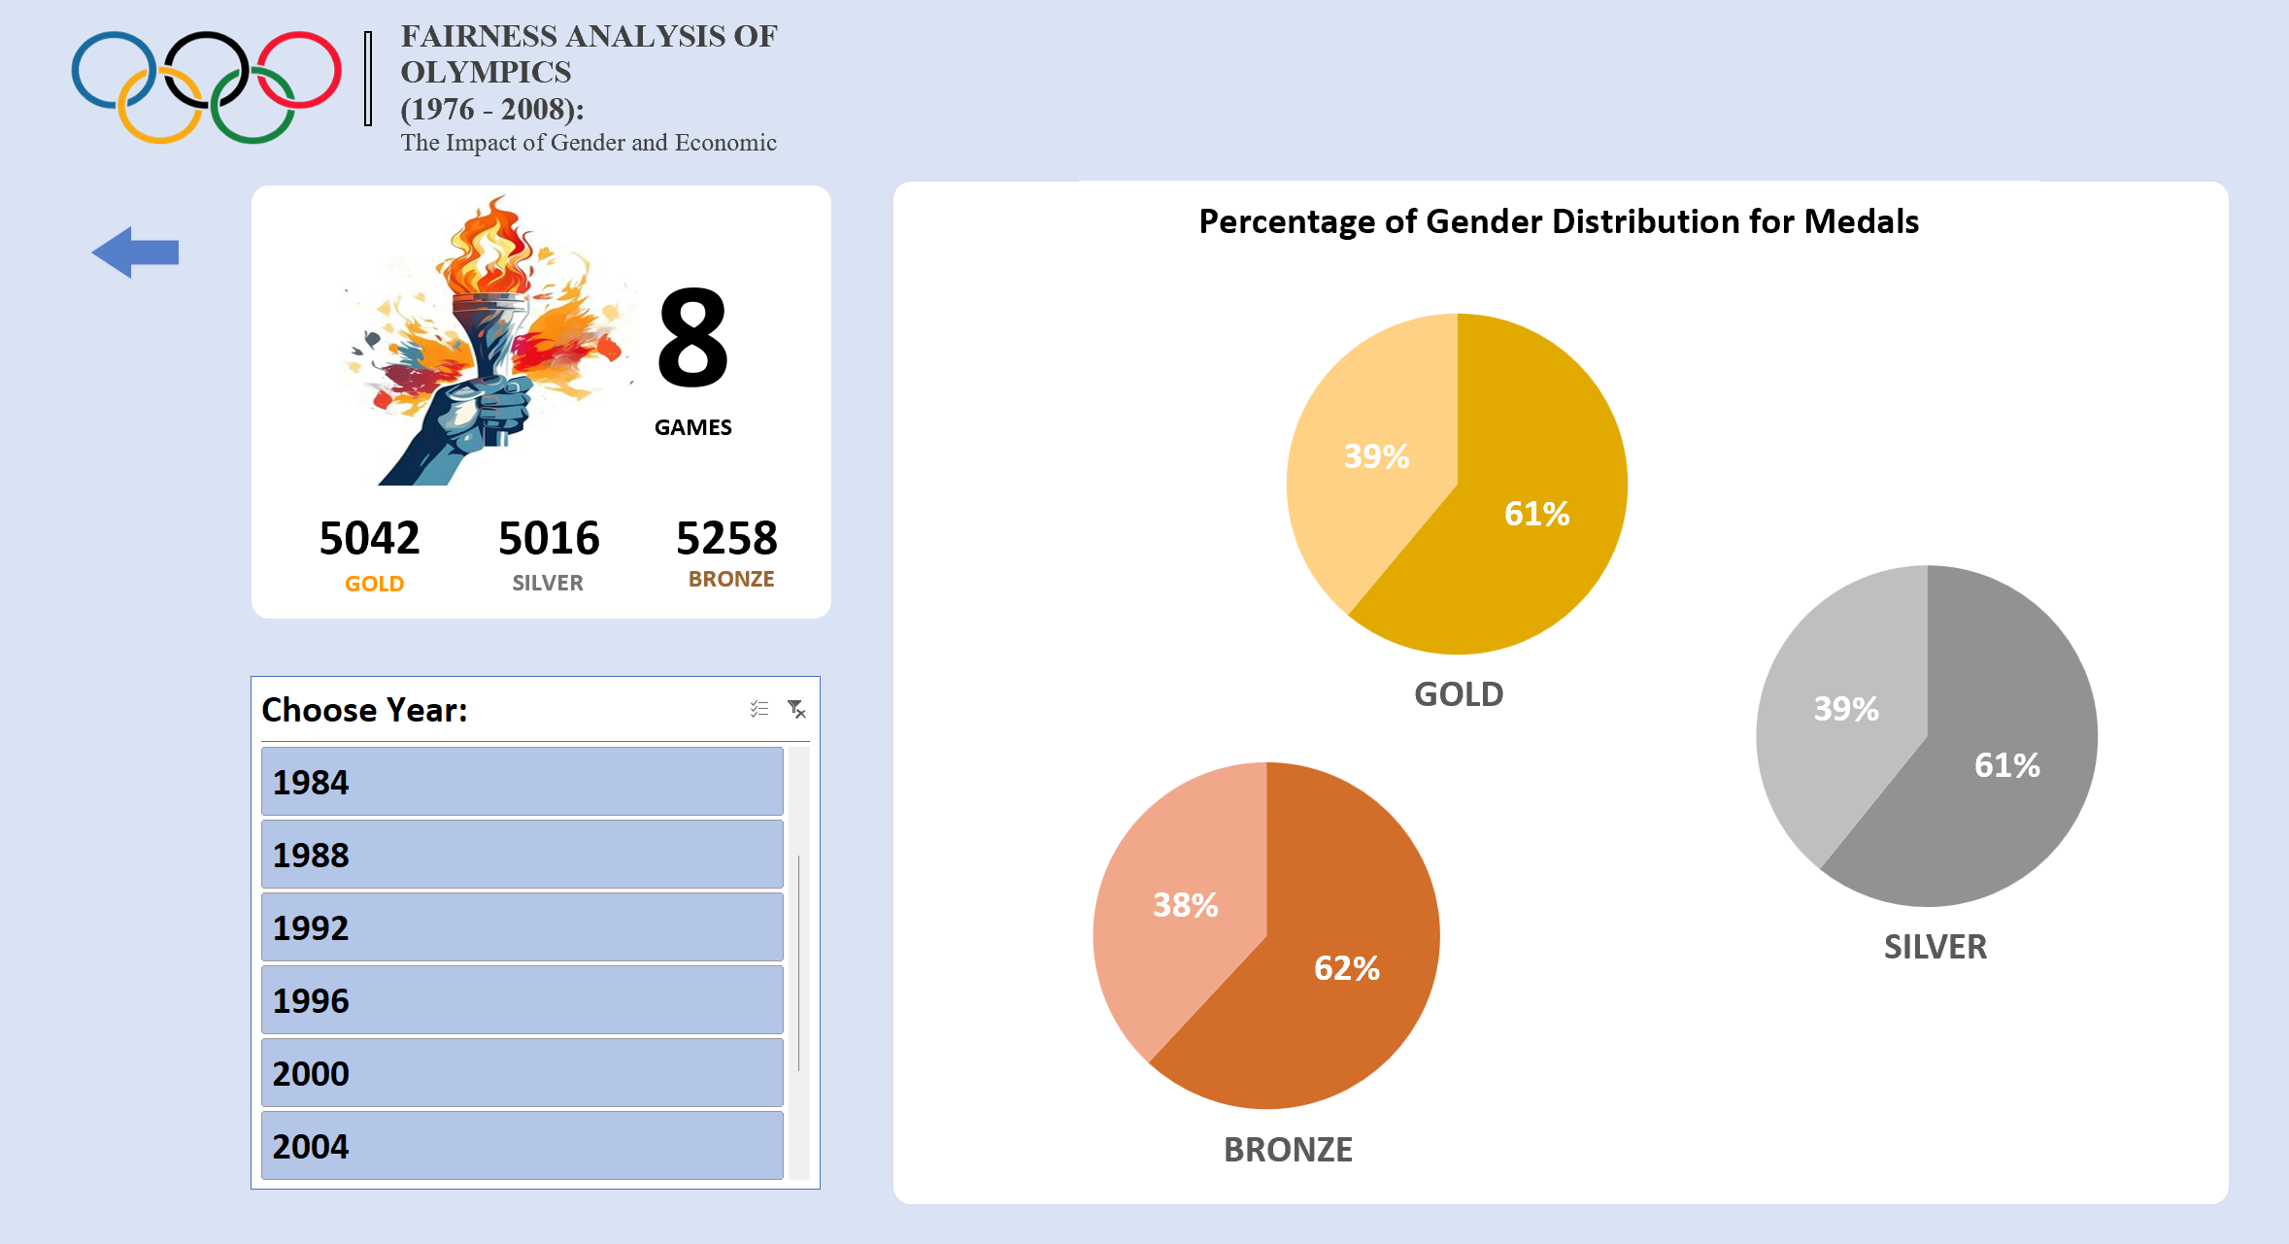

Slide 17
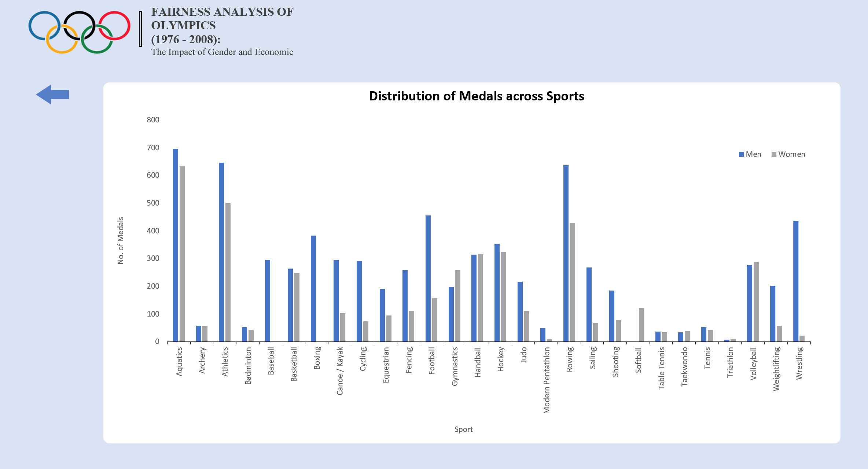

Slide 18
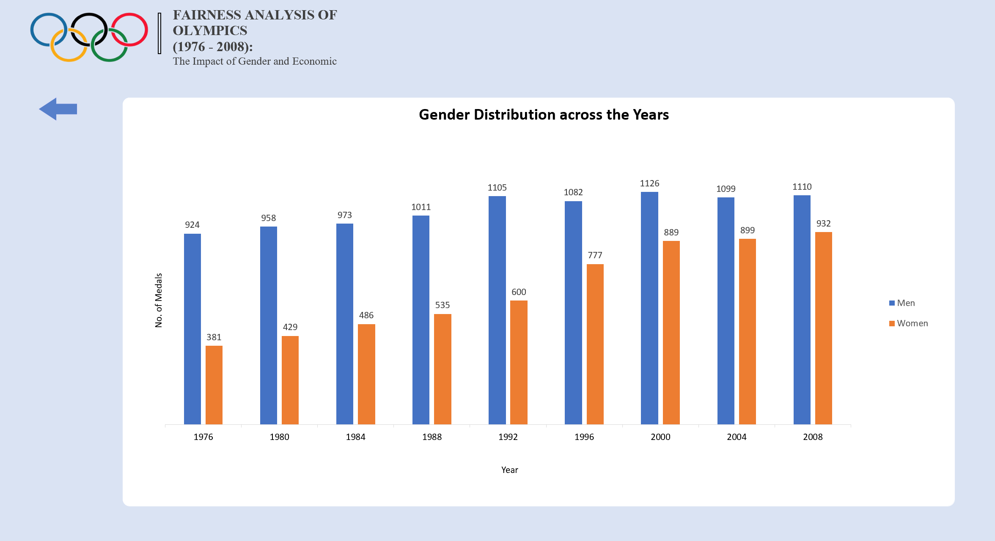

Slide 19
